Slide 1







Come let's enjoy learning

Slide 2




AI-ML Based E-Learning Platform
Leaving No-one behind/ Education is for all...
Education is a basic Human right, which is and should be necessary for everyone. Taking this fundamental right a step further in the digital world, we present Shiksha Mitra!
I want to get
EDUCATED

Slide 3



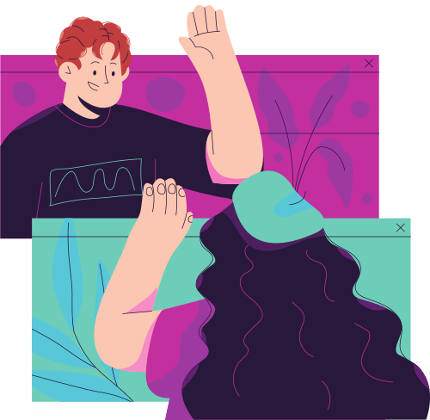
Moving into the advance digital world,, we are still not able to use the e-learning platforms up to the fullest
Interesting features
Here are some interesting features of our Shiksha Mitra.....

Slide 4




AI-ML BASED SUPERVISION
AI-BASED
What does your ward does online and how much time is the screen time, remains our top priority.
SUPERVISION

Slide 5
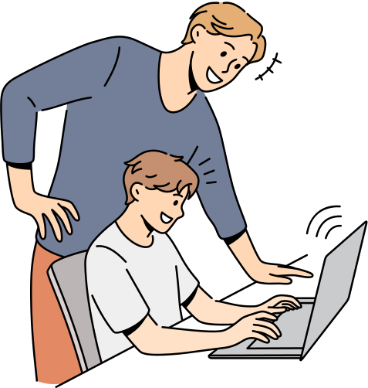


PARENTAL
CONTROL
A separate login portal will be there for the child's parent, which will be equpped with screen time, progress reports, child study pattern & parent-faculty interaction option.

Slide 6


Gamification of subjective topics in between focus modes to revise the previously learnt subjects/topics is the real gamechanger.
GAMIFICATION

Slide 7



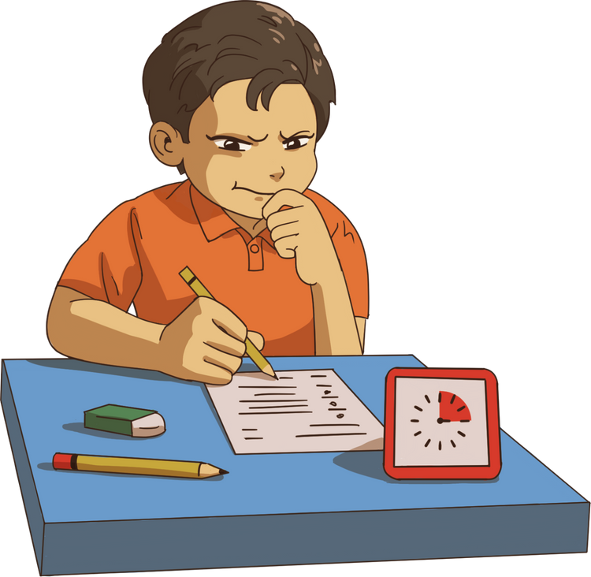

FOCUS
TIMER
The course videos will be played only for a period of 30 mins which will be followed by recess/revise time and then focus mode of 5 mins. This distribution of time is based on research that proves a student can concentrate on a topic for 30 mins on an avg.

Slide 8


SPEECH
ON
HOVER
This feature is especially for the disabled people having problems in reading(blind). It helps bridging the gap between the education of a Blind person.

Slide 9
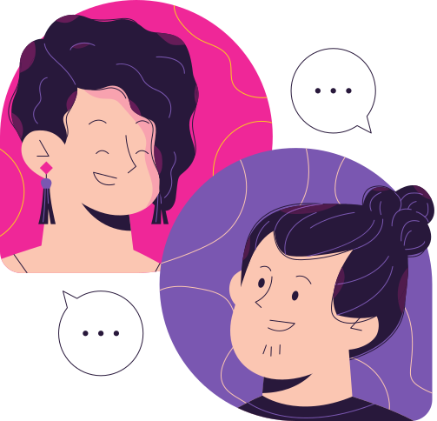


EXPERT
INSTRUCTORS
Our courses will be provided by well reputed and full of experience faculties. Each student will be getting individual attention.

Slide 10

Empowering students from Kindergarten to std 12, along with, JEE, NDA &NEET examination coaching courses are here to help your child succeed
1000+
COURSES

Slide 11



